Slide 1



Eelisa Water Study
Measuring and Improving Awareness and Collaboration among EELISA Community members using
Social Network Analysis
powered by Griffin
https://www.griffin.galaxyadvisors.com/
Notes:
1. Smthg clarify happy to be interrupted or smthg to add
2. Thanks Griffin
3. Thanks to Eelisa Water for choosing me

Slide 2
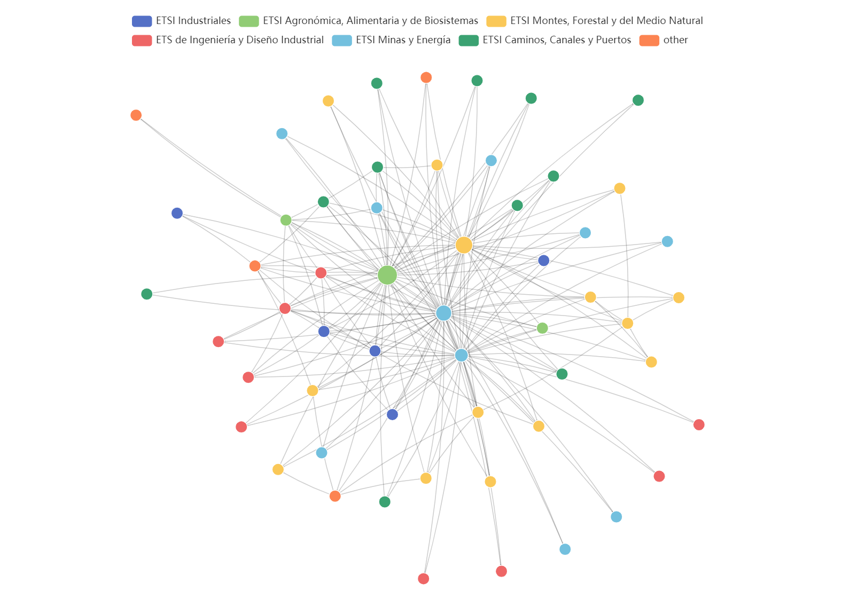
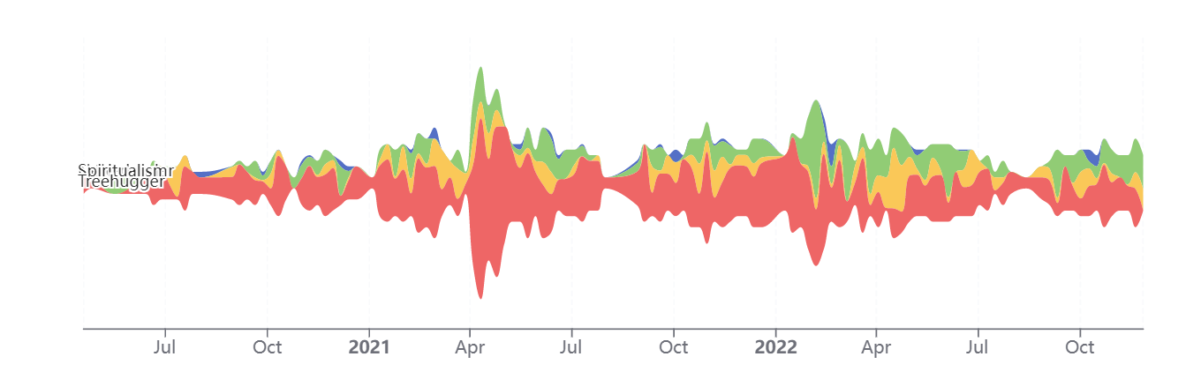
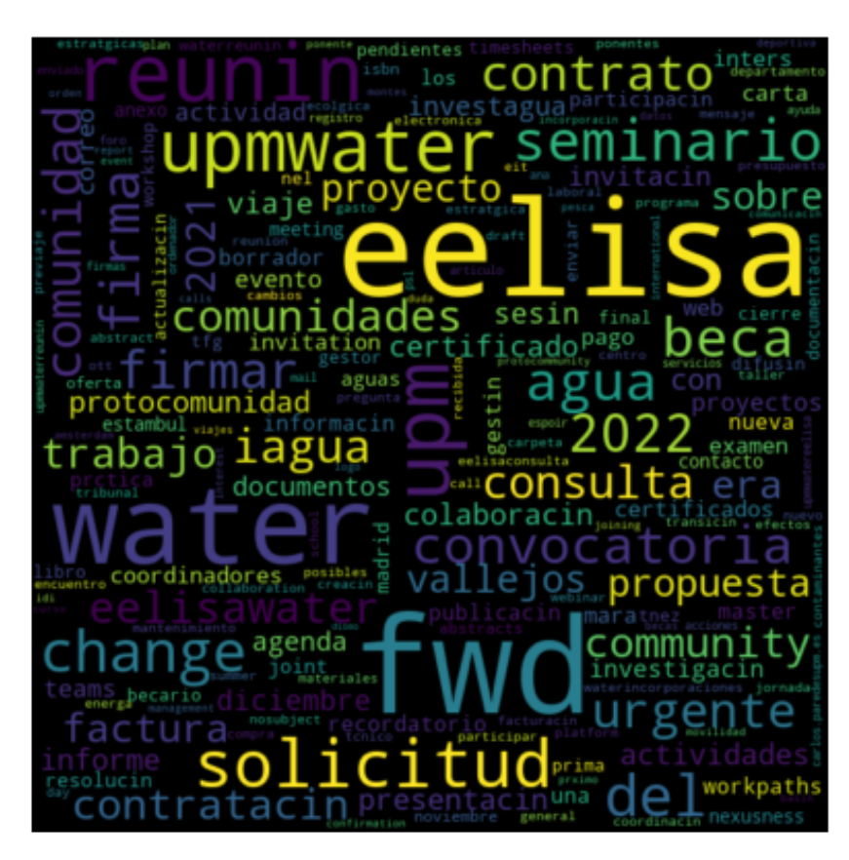
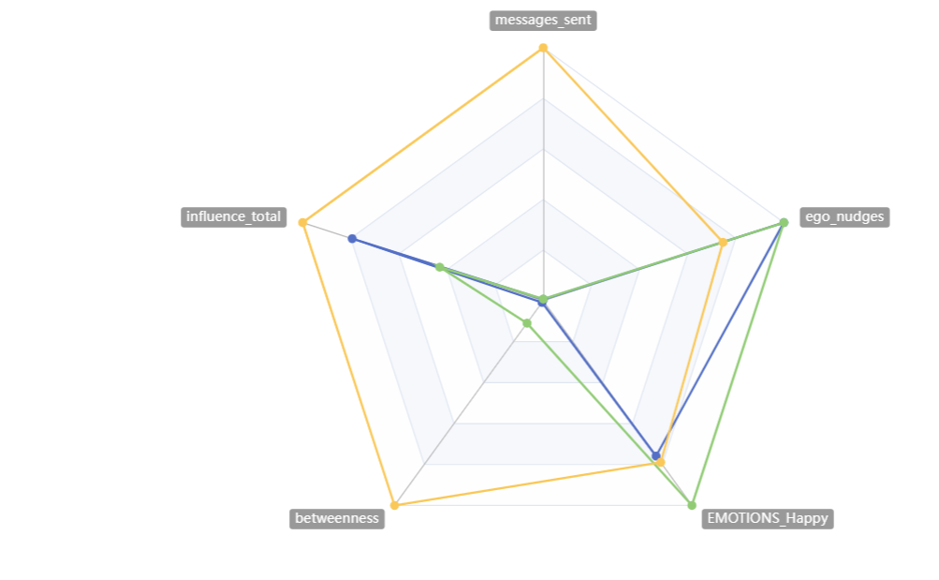
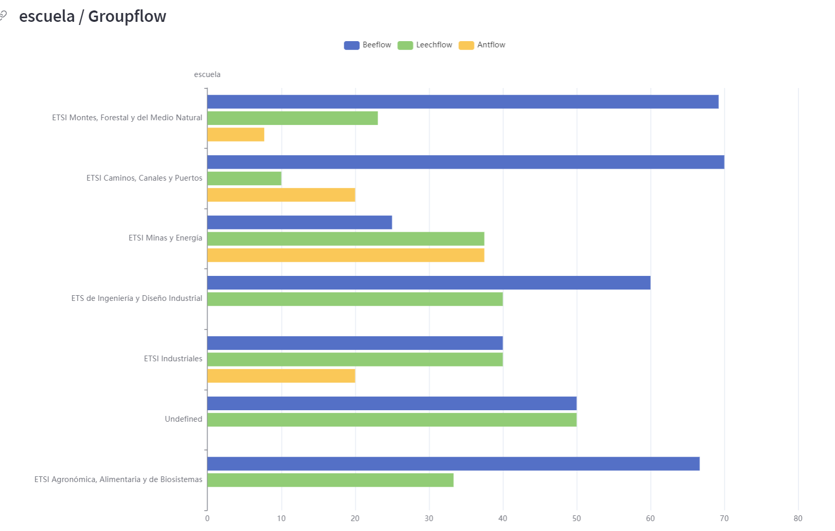
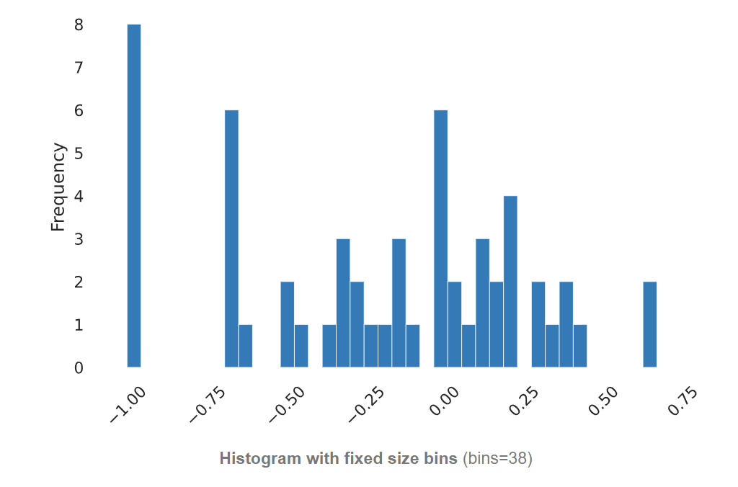
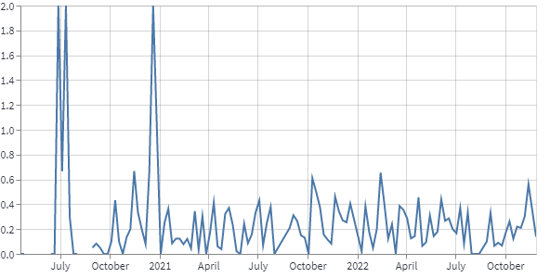
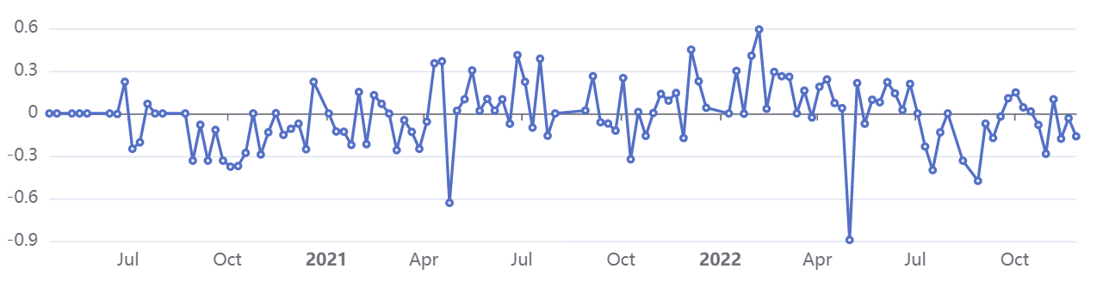
What do you think you know about your community?
How many variables could be measured?
Notes:
I will give you a minute to think about your perspective of Eelisa Water, this exercise is useful to be able to contrast later
Think what are your expectations about the study
How many metrics could be measured?
How are they going to be presented? Will the graphics be repetitive? Will you be able to easily understand them?
Think about the insights, are they going to match with your perspective?

Slide 3
Index
Introduction 4
Insights 8
Advice 17
Community Metrics 25
Contribution Index 29
Betweenness 33
Emotions 35
Alternative Realities 38
Groupflow 43
Summary 48
Notes:
Don’t be scared for all the pages | instead of grouping all the information together I
wanted to separate the ideas into different slides | more dynamic | you’ll notice I won't dwell too much on many | are self-explanatory
2 parts, second one is more technical and useful to further comprehend the 1st
30min

Slide 4
Introduction

Slide 5
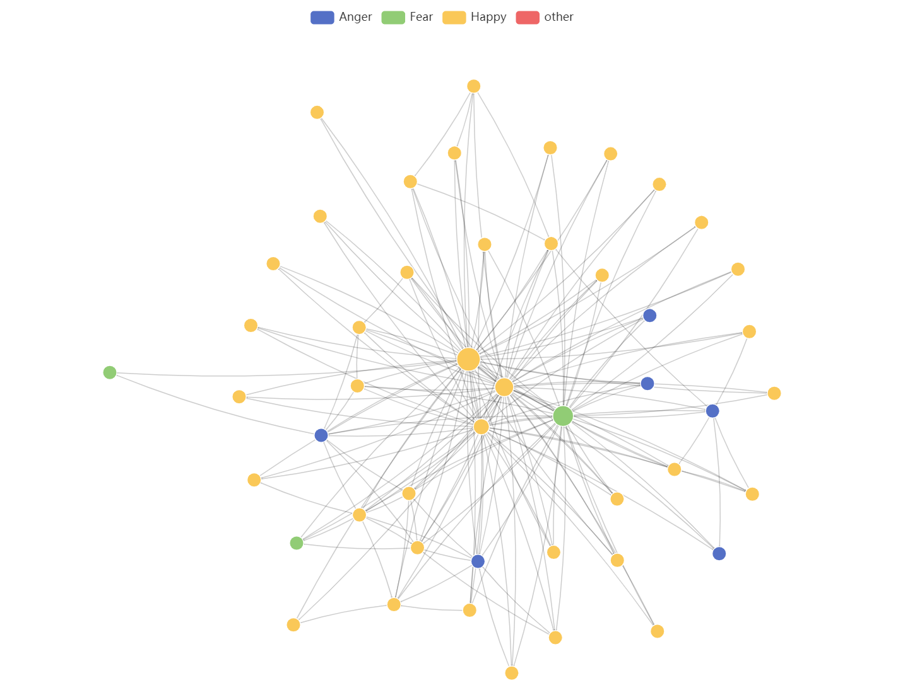
Scope of email analysis
Initial approach
Data collected
53 researchers
55 nodes
1850 edges
2 people from
support staff
2 community emails:
- eelisawaterchange.community@upm.es
- EELISACommunitiesUPM…@upm...com
Notes:
Alberto Garrido & Sonia Rayo, community entities
Explain how network works, proximity, node and edge (the more messages they send, the closer they are) (central nodes are closer to everyone than everyone else)

Slide 6




Data handling process
1. Extraction
2. Cleaning
3. Processing
IntoCommunity
SeparateRows
Anonymize
Griffin
https://www.griffin.galaxyadvisors.com/

Slide 7
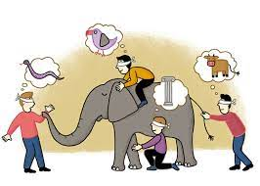


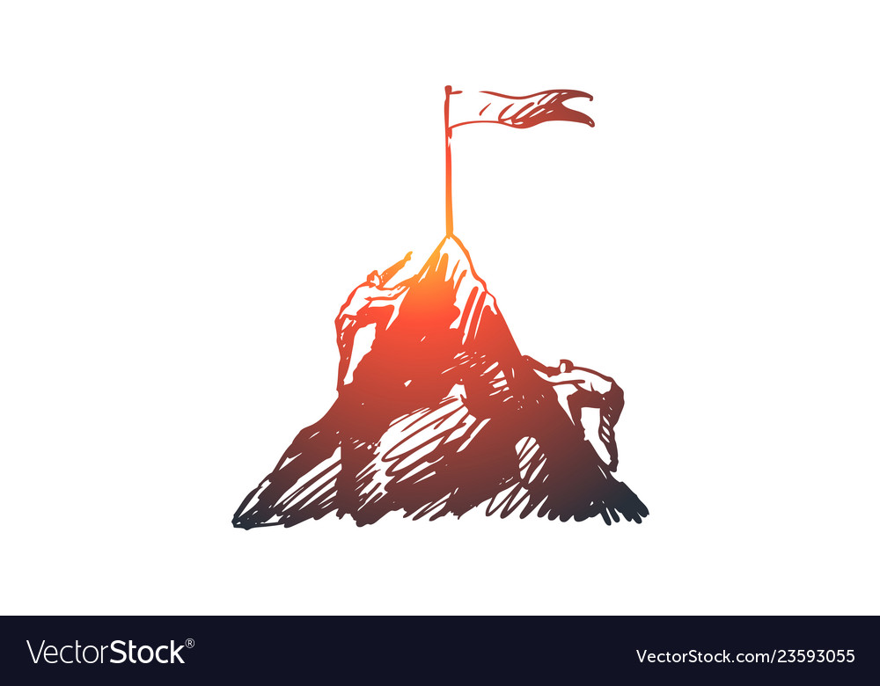
Initial concepts
Data rigor
Insight - oversight
Benefits of communication skills
No pain – No gain
Notes:
Visual effects
We think we know exactly who we are, but think how that image is biased by our own perceptions, it could be different from what others see or the analysis shows
Performance will be higher if you know how to communicate, and you are going to feel happier
It is hard but, sometimes you need to admit your weaknesses to become your best version

Slide 8
Insights

Slide 9

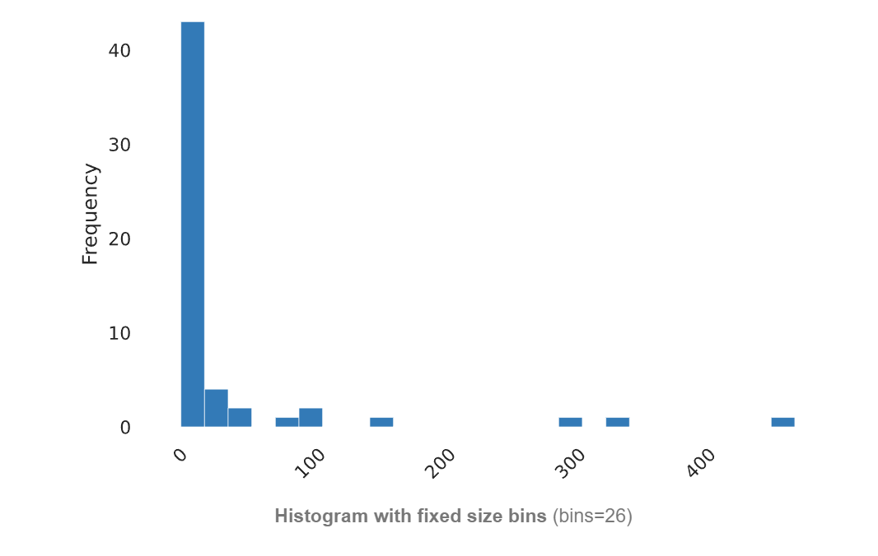
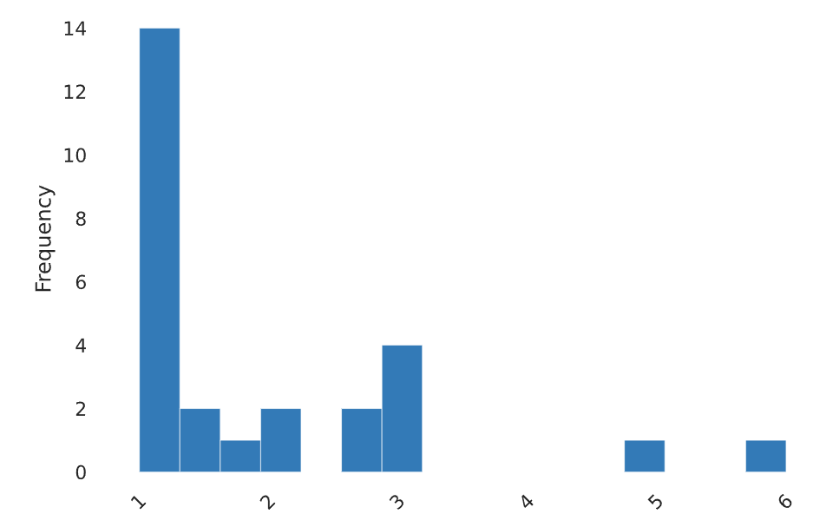
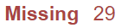
1
More than 50% of the community is mainly inactive
Messages sent
Ego nudges
Messages sent
Ego nudges
Average number of follow-ups that the sender needs to send to receive a response from the receiver
8 people: 0 messages
27 people: <5 messages
40 people: <10 messages
Notes:
1. Explain histogram: how much of each value
2. Ego nudges: Average number of follow-ups that the sender needs to send to receive a response from the receiver, so the lower the better because it means you respond

Slide 10
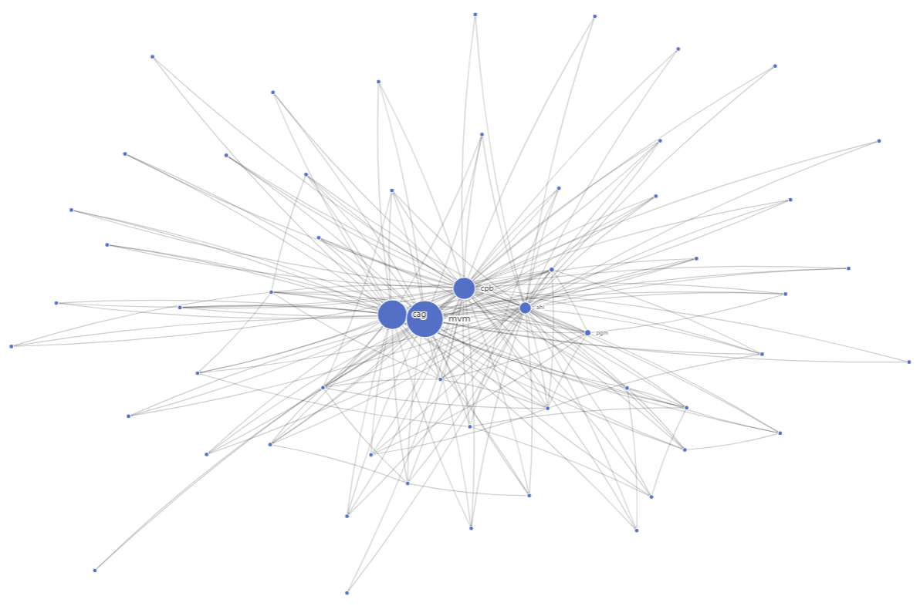

2
Community is driven by a very small core!
sized by betweenness
Notes:
1. Betweenness is probably the most informative value in SNA

Slide 11

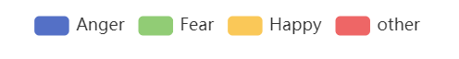
3
70% of the community are mostly happy individuals, this group send 3x more messages than the others
Notes:
Not discrete value

Slide 12
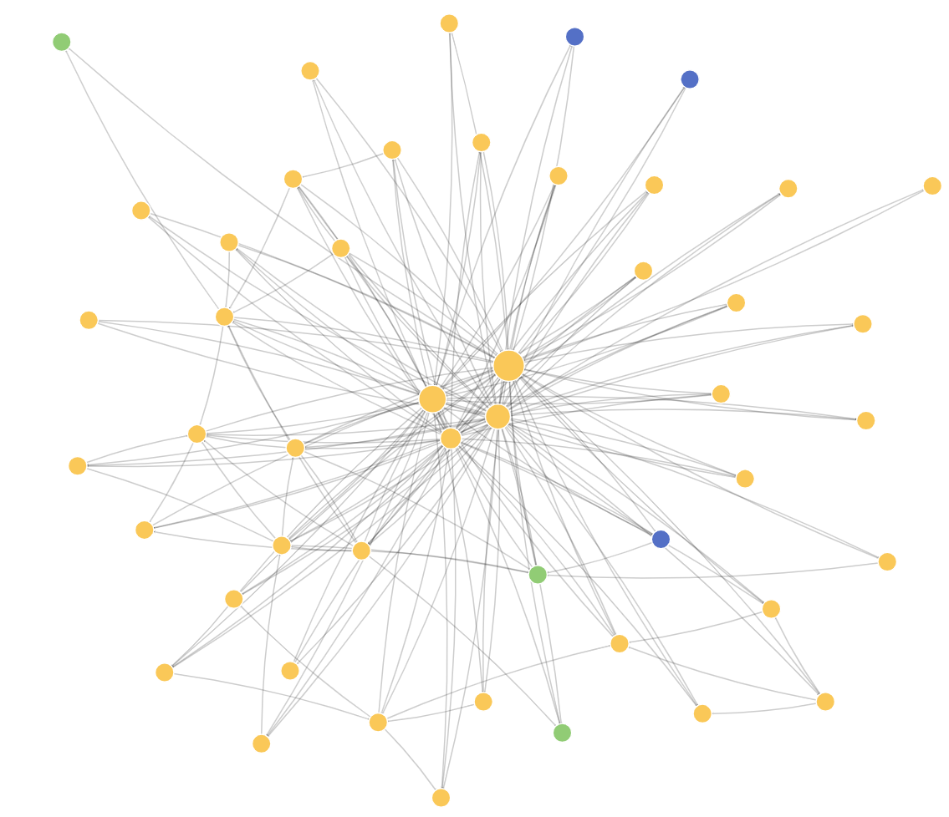
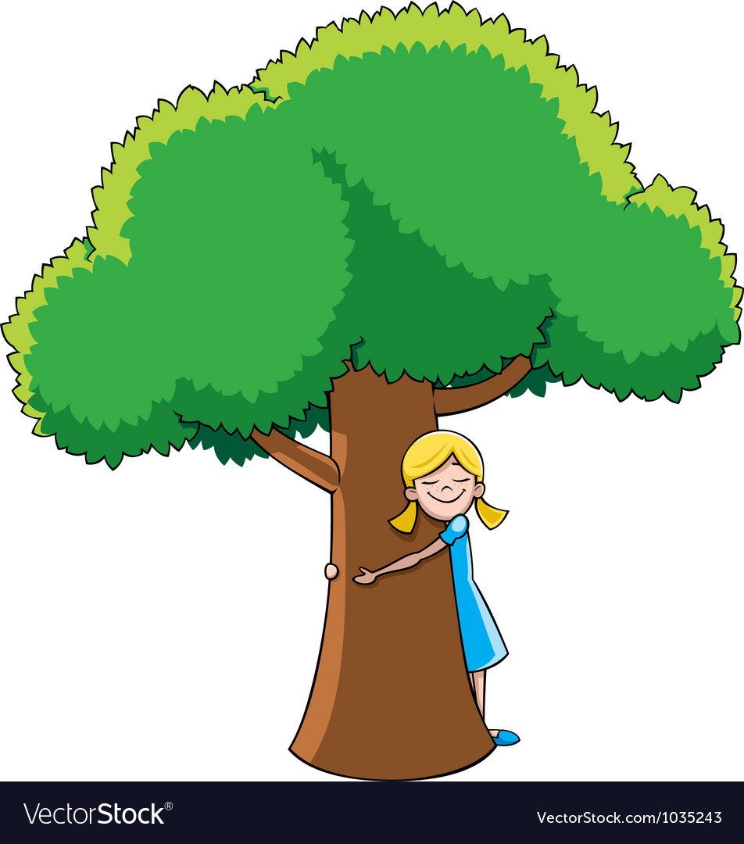
4
88% of those analyzed are treehuggers, only
they send messages and have betweenness

Slide 13
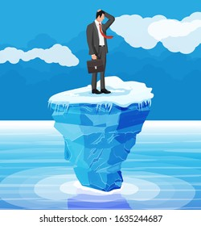
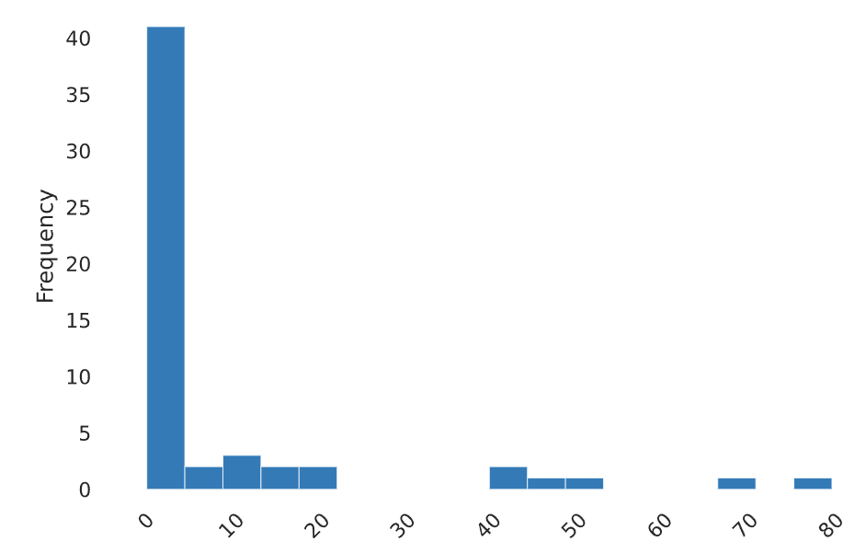
5
75% of the community is too static
Contribution Index Oscillation
Contribution Index
Notes:
1. When a community of equals face different challenges, it should happen that different people contribute differently at different times.

Slide 14
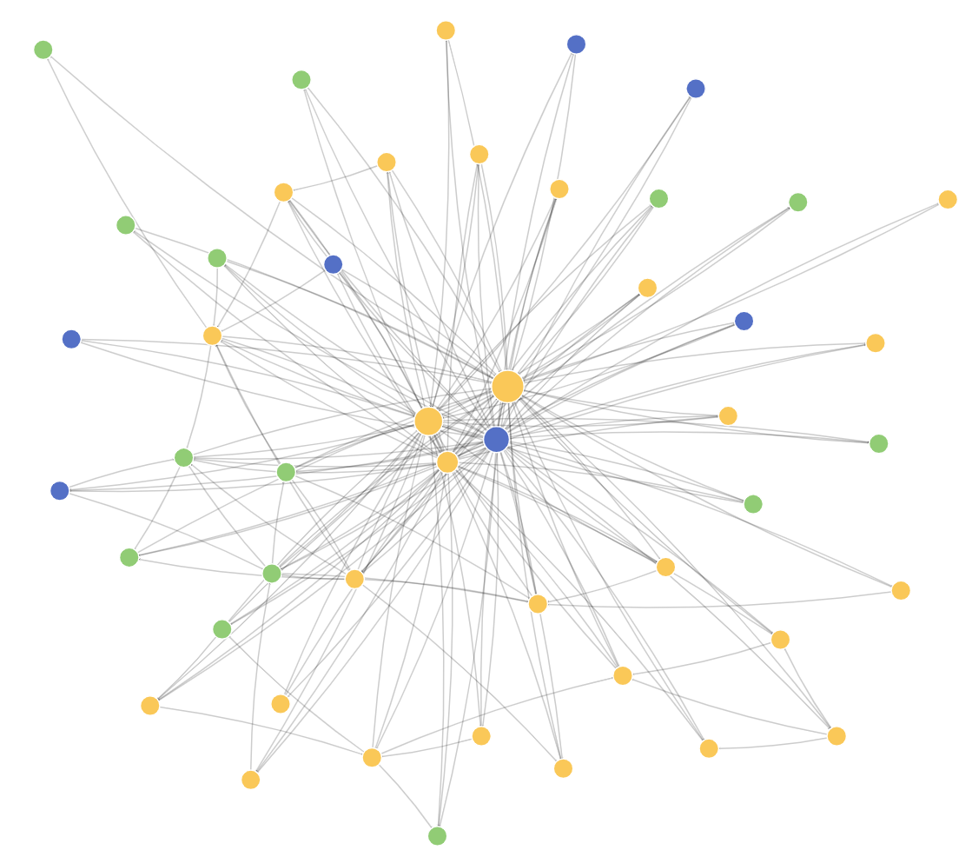
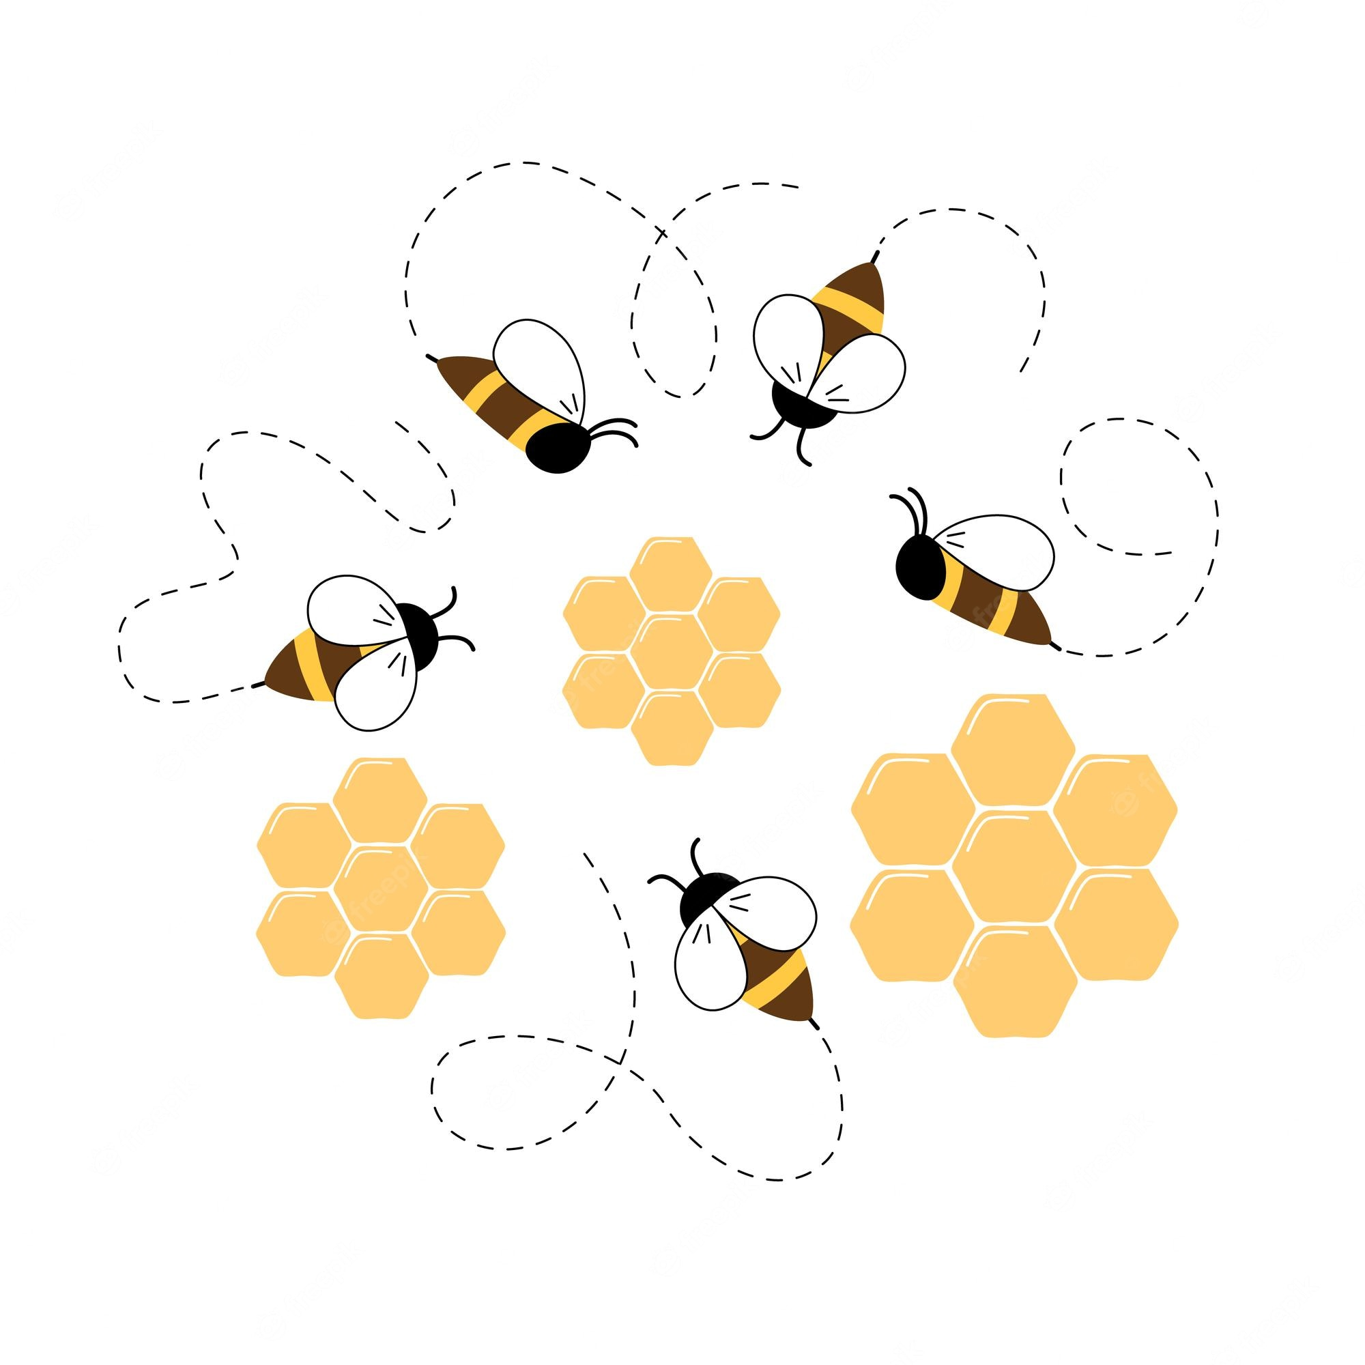
6
Only 27 individuals have been classified as bees,
bees are the only ones that can create Groupflow
Notes:
1. Explain later, but to early introduce you think the bee as the optimal role to collaborate

Slide 15

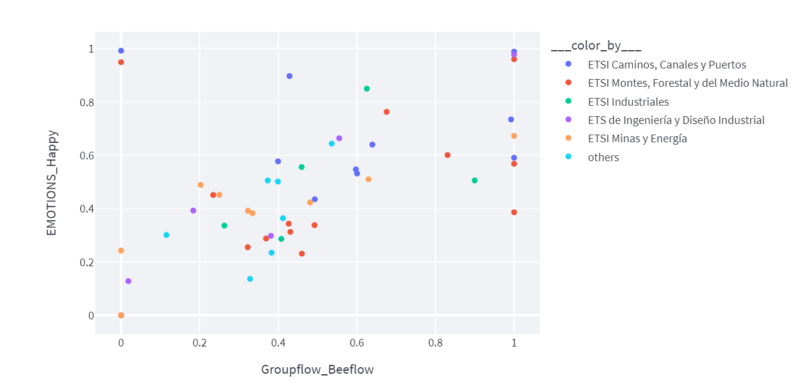
7
The more bee you are, the happier!

Slide 16

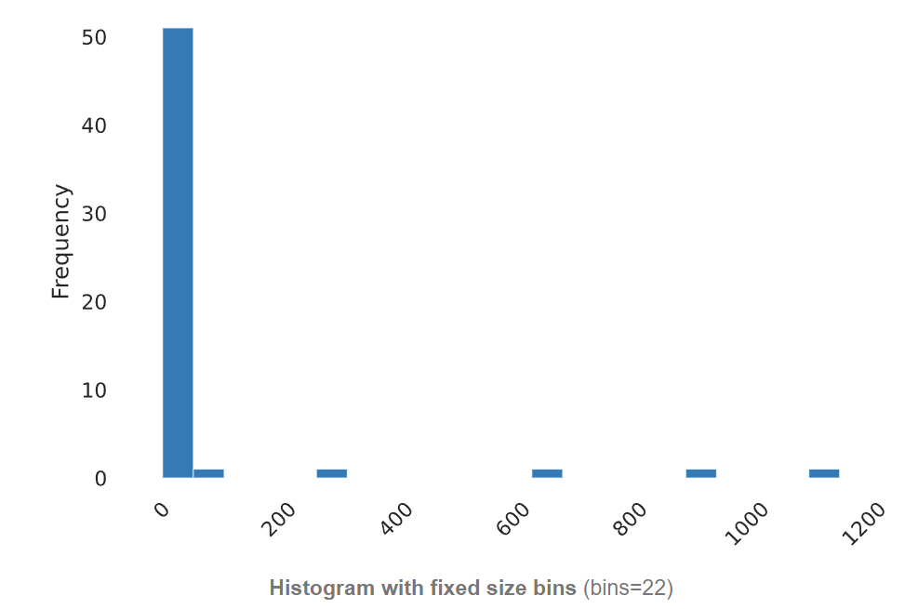
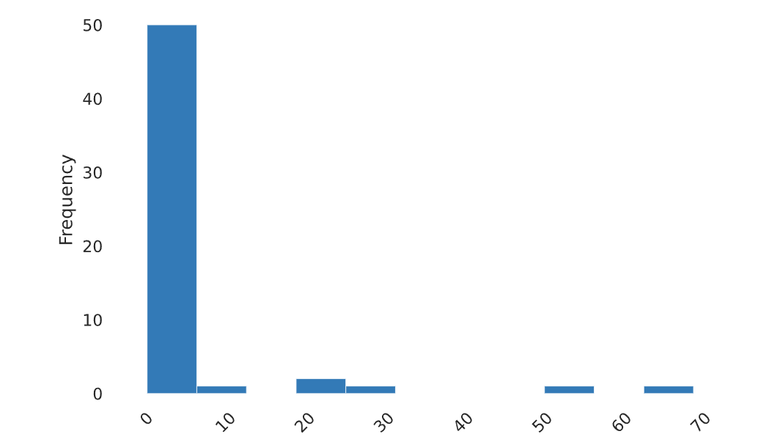
8
The community is overcentralized,
and central nodes remain unchanged
Betweenness
Betweenness oscillation
Betweenness
Betweenness oscillation

Slide 17
Advice to enhance
Collaboration
Notes:
1. The advice is mainly not for you as you are doing the best, but it is nice that you hear

Slide 18
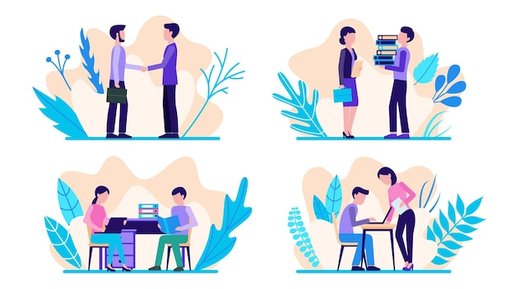

1
Establish more ties with people in the community
Stronger connections to the right people help you get
things done
Being a broker in the network allows you to control the flow of info
Notes:
many people have very few connections, this seems like a problem

Slide 19
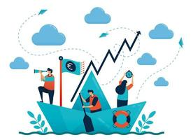
2
Embrace creativity and openness to change
The ability for a person to change network position indicates
willingness to allow the best
qualified people to lead depending
on the context, showing high creativity, good collaboration
and communication

Slide 20
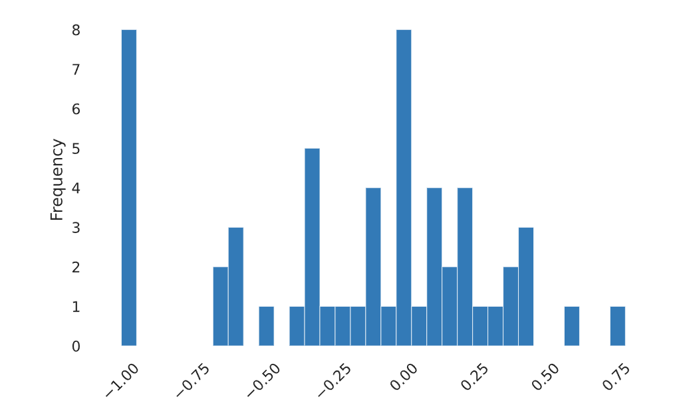
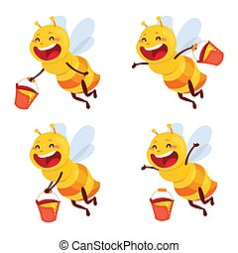
3
Try to achieve a balanced contribution
Balanced sending/receiving ratio indicates better collaboration
Contribution Index

Slide 21


4
The faster you respond, the more
your enthusiasm will be felt
Many messages received until replying indicates
a lack of passion

Slide 22
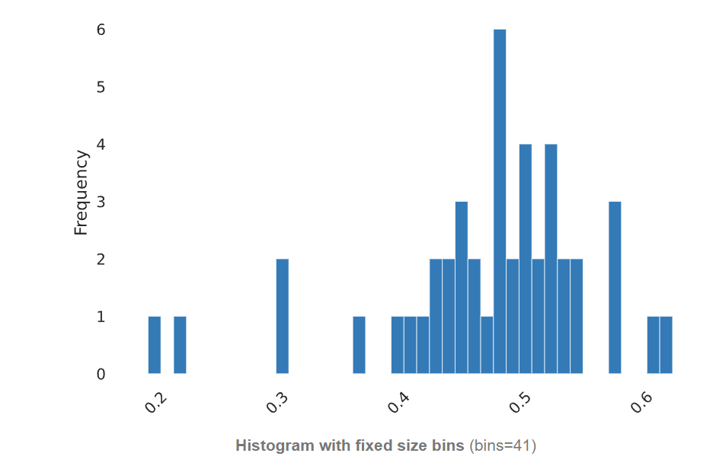
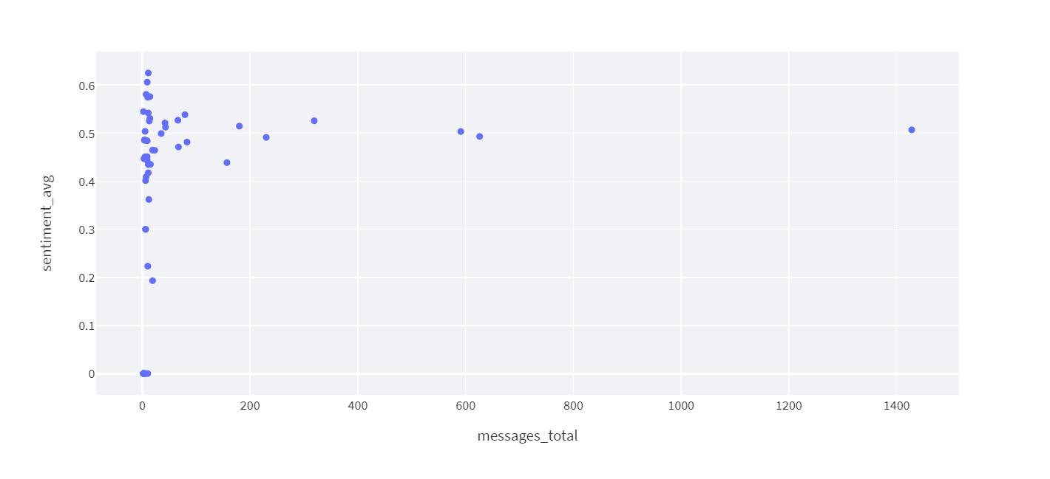

5
Elevate your Sentiment without
compromising Honest Language
The higher the sentiment, the more positive you are about the prospect of
the community
Sentiment
Notes:
Indicates positivity and negativity of communication
Being nice is nice, being honest is better

Slide 23
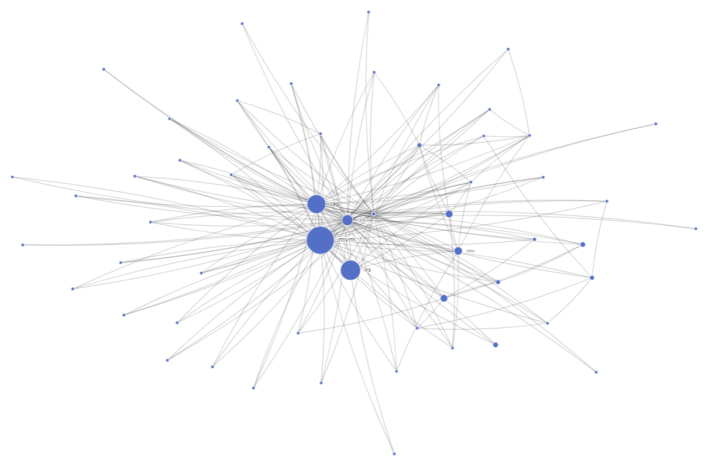

6
Encourage a more pro-active communication style, not only the passive information consumption
sized by messages sent
23

Slide 24
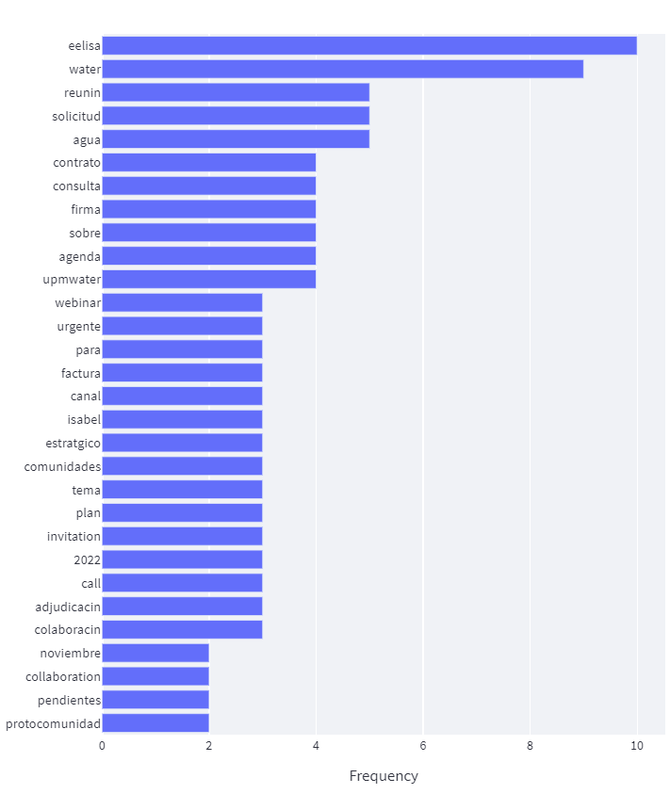

7
Bring in fresh ideas, right now focus is on too much repetitive administrative work
24
Notes:
Not the most inspiring words, not new concepts introduced

Slide 25
Community Metrics

Slide 26
Eelisa Water Network
Notes:
Try to guess where you are, not a surprise you 3 are central nodes in the network

Slide 27
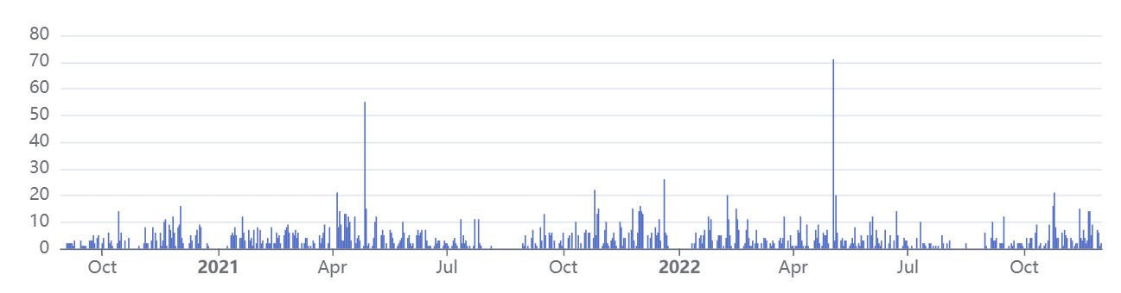
Number of edges over time
Notes:
Edges are the connections between nodes
It seems later April there is an increase

Slide 28
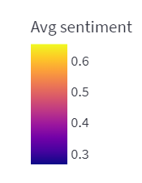
Word Cloud

Slide 29
Contribution Index
Balance of communication in terms of sent and received messages
(P. A. Gloor, 2017, p. 52)

Slide 30
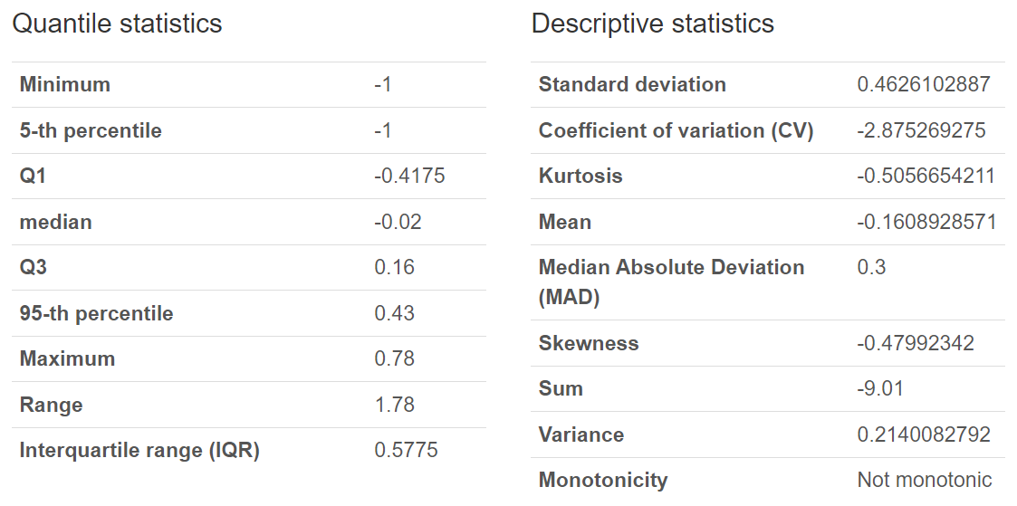
Contribution Index
Contribution Index
Notes:
From -1 to 1
deflected mainly to the left

Slide 31
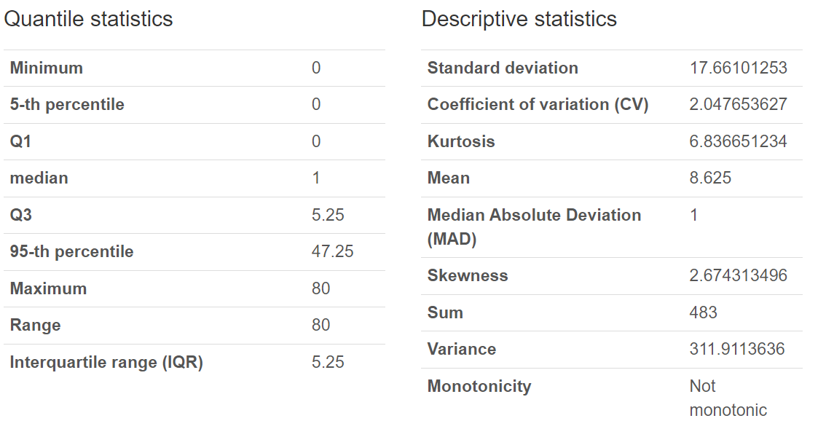
Contribution Index Oscillation
Contribution Index Oscillation

Slide 32
Betweenness
Measure of the extent to which each actor acts as an information hub
(P. A. Gloor, 2017, p. 52)
Notes:
Calculation: Likelihood to be on the shortest path between any two actors
From -1 to 1
One of the most important metrics

Slide 33
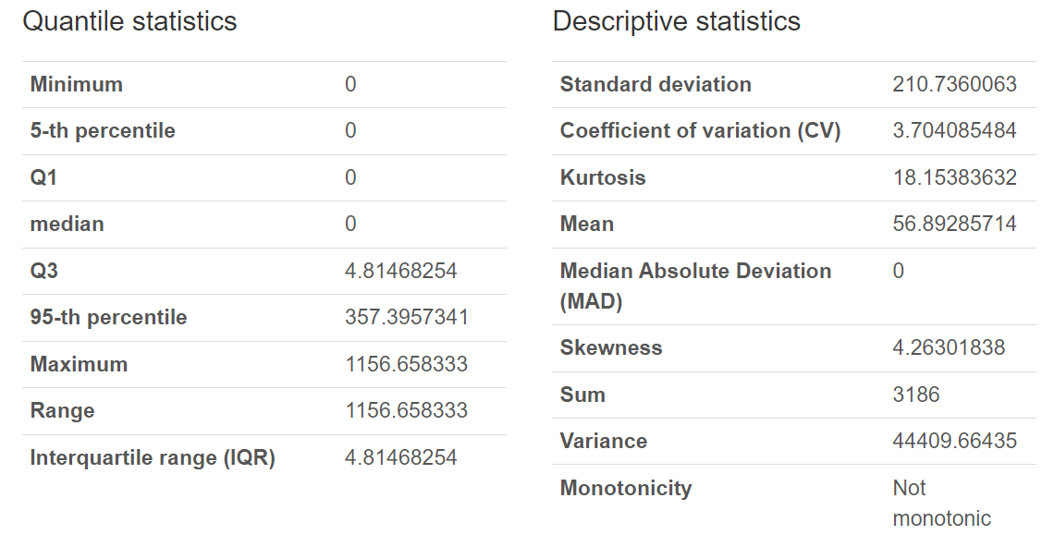
Betweenness
Betweenness

Slide 34
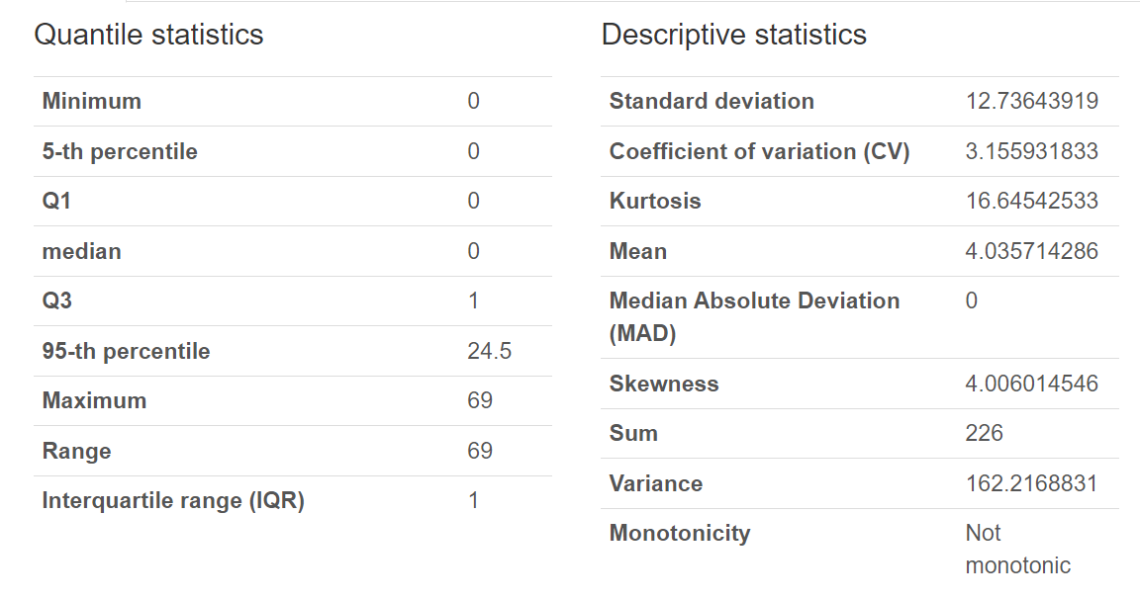
Betweenness Oscillation
Betweenness Oscillation

Slide 35
Emotions

Slide 36
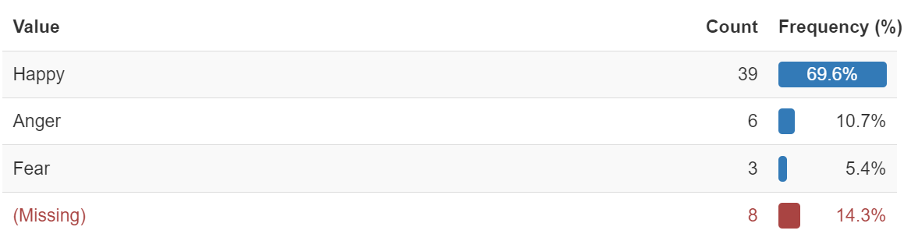
Eelisa Water Network
By Emotions
Notes:
1. Explain emotion is not a discrete value,

Slide 37
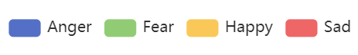
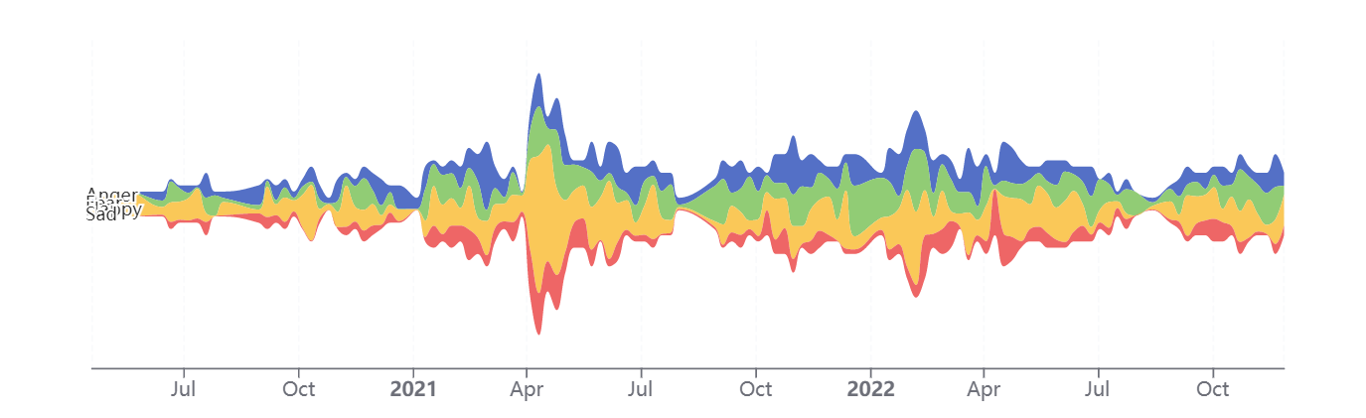
Emotions over time

Slide 38
Alternative Realities
Four categories useful for understanding the general characteristics of an individual
(P. A. Gloor, Happimetrics)
Notes:
[-1,1]

Slide 39
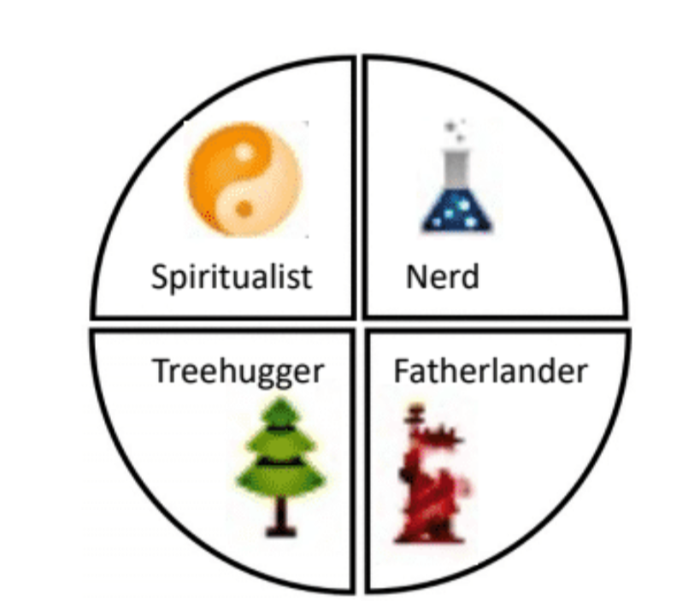
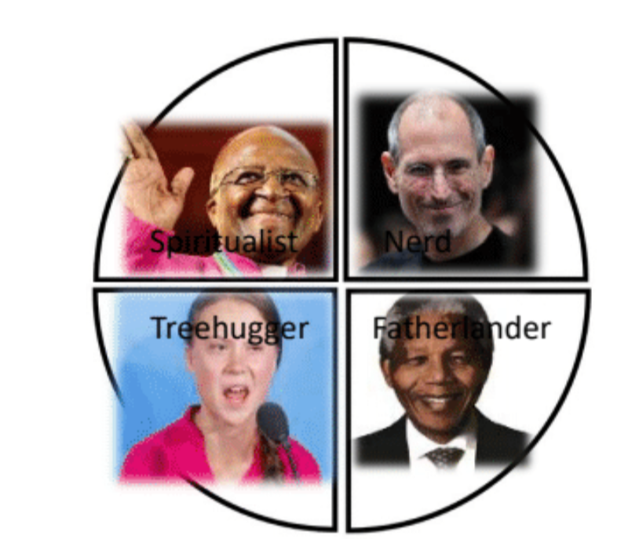
Alternative Realities explanation
(Figures from Happimetrics)
Notes:
This is kind of simplification should not be used to exclusive clasification ,these categories are useful for understanding the general characteristics of a person.
Spiritualists: provide spiritual guidance | priests, pastors, yoga teachers all fit this archetype.
Nerds: engineers and scientists, always obsessed with the creation of new objects, passionate about technology
Fatherlanders their great impulse is to defend their land, politicians, soldiers, and policemen.
Treehuggers protest to the (over)use of technology, wanting to protect nature to create amore sustainable style of living

Slide 40
Eelisa Water Network
By Alternative Realities

Slide 41
Alternative Realities over time

Slide 42
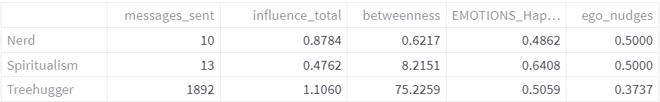
Alternative Realities Radar

Slide 43
Groupflow
It enables teams to reach their highest productive and creative state
(P. A. Gloor, Happimetrics)
Notes:
[-1,1]

Slide 44


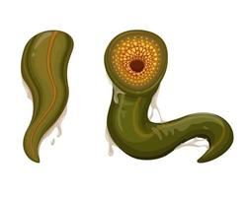
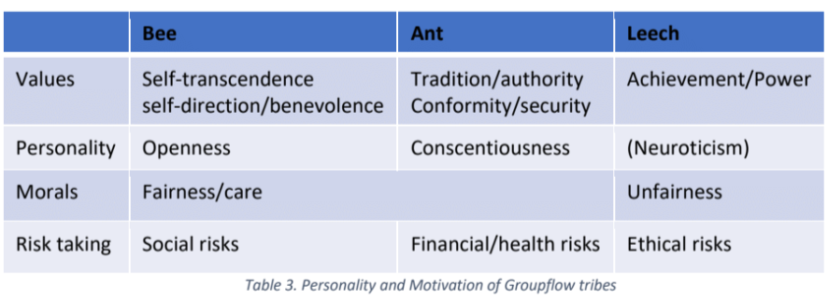
Groupflow explanation
Antflow
Beeflow
Leechflow
(Table from Happimetrics)
Notes:
Ants: close minded | things will be always the same | win or lose | not intrinsically bad just scared
Leeches: Power no matter what | they drain your energy | no altruistic morals | jungle
3. Desirable flow | Win win situations | not scare of givin | pure moral purpose | they tend to think collectively beehive | bring honey

Slide 45
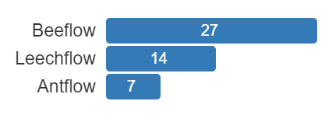
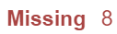
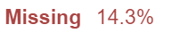
Eelisa Water Network
By Groupflow

Slide 46


Groupflow over time

Slide 47
Happiness - Beeflow

Slide 48
Summary
Notes:
[-1,1]

Slide 49
Insights
Advice
1
More than 50% of the community is mainly inactive
1
Establish more ties with people in the community
2
Community is driven by a very small core
2
Embrace creativity and openness to change
3
70% of the community are mostly happy individuals, this group send 3x more messages than the others
3
Try to achieve a balanced contribution
4
88% of those analyzed are treehuggers, only
they send messages and have betweenness
4
The faster you respond, the more
your enthusiasm will be felt
5
75% of the community is too static
Elevate your Sentiment without
compromising Honest Language
5
6
Only 27 individuals have been classified as bees,
bees are the only ones that can create Groupflow
6
Encourage a more pro-active communication style, not only the passive information consumption
7
The more bee you are, the happier!
Bring in fresh ideas, right now focus is on too much repetitive administrative work
7
8
The community is overcentralized,
and central nodes remain unchanged

Slide 50



Thanks for your attention!
I am Álvaro Francisco Gil
Notes:
What did you think of the study? Do the results match what you had in mind?

